Slide 1

YTP Arduino – Lesson 1
Instructors: Pete, Kai
© nexgen codecamp pty ltd

Slide 2
Goals
To understand the question “What is Electricity?”
To have an awareness of different electronic components.
To be aware of the necessity of safety when dealing with electricity.
Success Criteria
Play the component game
Watch videos on electricity
Know what voltage, current and resistance is
Understand safety aspects of electricity
© nexgen codecamp pty ltd

Slide 3
What is your favorite activity?
What is your favorite ‘bit’ of technology?
© nexgen codecamp pty ltd

Slide 4
Component Game
Jumper wire
Resistor
Switch
Ceramic Capacitor
Battery
LED
Electrolytic Capacitor
© nexgen codecamp pty ltd

Slide 5
Component Game
?
© nexgen codecamp pty ltd

Slide 6
What is Electricity?
© nexgen codecamp pty ltd

Slide 7

What is Electricity?
© nexgen codecamp pty ltd

Slide 8
Electricity
Voltage, Current and Resistance
-
-
-
-
-
-
1.5v
© nexgen codecamp pty ltd
Notes:
Content:
Images showing different types of ‘current’
Objectives:
Students should understand the concept of an electric current.
Narrative:
Ask about the energy in this diagram. Where is it coming from?
Introduce electrons and electron flow
Introduce voltage, current and resistance

Slide 9

Resistance
© nexgen codecamp pty ltd
Notes:
Content:
A comedic illustration of resistance
Objectives:
To connect the resistor from the game to ‘resistance’
Students should understand the meaning of resistance
Students should understand Current is measured in Amps, Resistance in Ohms and Voltage in Volts.
Narrative
Connect different materials to a battery to illustrate to the class that some materials do not ’conduct’ electricity because of resistance.

Slide 10
© nexgen codecamp pty ltd
Notes:
Content:
An image declaring that safety when dealing with electricity is very important
Objectives:
Students should understand that electricity can generate a lot of heat.
Electricity can kill
Safety around electricity is everyone’s responsibility.
Actions:
Use my Mac power supply as an illustration of safety and electrical heat
We know that lightning can set things on fire i.e. heat!

Slide 11

© nexgen codecamp pty ltd
Notes:
Content:
Video showing how lightning is a pure demonstration of electricity.
Objectives:
To illustrate the power of electricity
To illustrate the reality of electricity and make it memorable
Students should understand that safety is paramount when dealing with electricity
To relate electricity to power
Narrative:
Get the students to listen to the video with the intent of answering questions after.
How often does lighting occur? 50-100 times a second
Where does lightning strike most? Himalayas, Central Africa, South America
How hot does the lightning path get? 50,000 degrees fahrenheit
Where is the best place to shelter from lightning? In a building or car

Slide 12
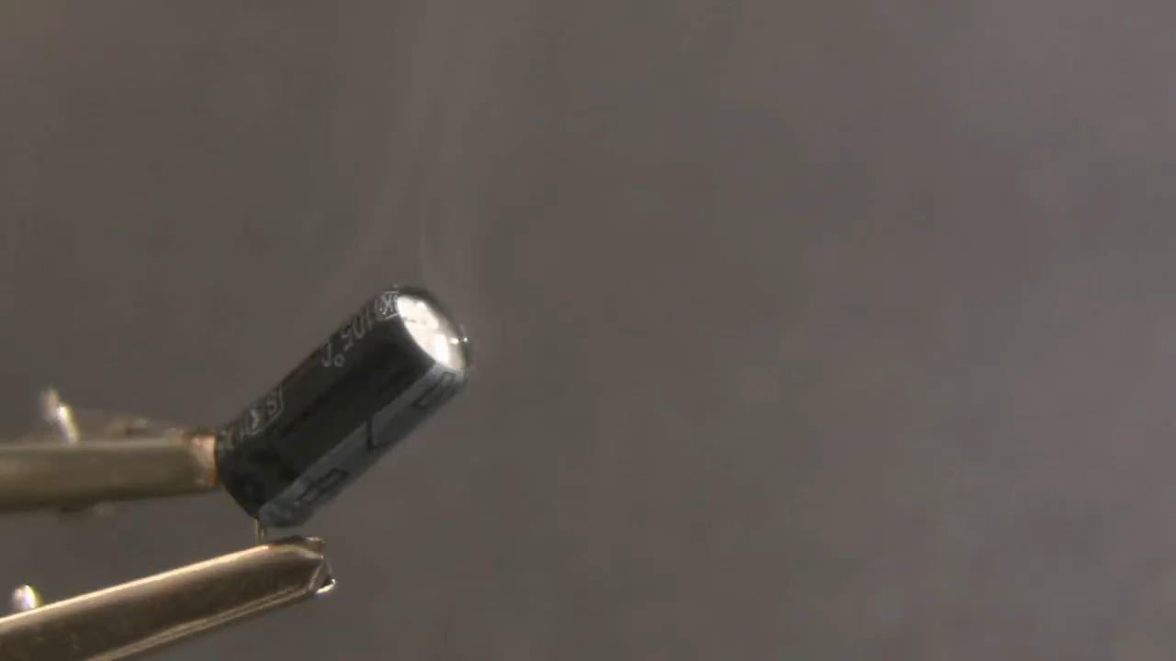
Safety and Electronic Components
© nexgen codecamp pty ltd
Notes:
Content:
A video that shows components exploding and catching fire
Objectives:
Students will understand that they should be careful with components
Narrative:
NONE

